Slide 1
AI for Medicine
Lecture 8:
AI Applications in Medicine – Part III
Feb 07, 2022
Mohammad Hammoud
Carnegie Mellon University in Qatar

Slide 2
Today…
Last Monday’s Session:
AI Applications in Medicine – Part II
Today’s Session:
AI Applications in Medicine – Part III
Announcements:
Assignment 2 will be out by tonight. It is due on Feb 15 by midnight
Quiz I will be on Feb 21

Slide 3
Outline
Introduction
What is AI?
Administrivia
AI Applications in Medicine

Slide 4
Some Applications of AI in Medicine
Diagnosing diabetic eye disease using deep learning [1]
Detecting anemia from retinal fundus images using deep learning [2]
Predicting cardiovascular risk factors from retinal fundus photographs using deep learning [3]
Extracting symptoms and their status from clinical conversations using recurrent neural networks [4]
Performing differential diagnosis using probabilistic graphical models [5]
Predicting osteoarthritis using machine learning [6]

Slide 5
Digital Health Has Become Ubiquitous
Everyday millions of people turn to the Internet for health information and treatment advice
In Australia, around 80% of people search the Internet for health information, and nearly 40% seek guidance online for self-treatment
In the US, almost two-thirds of adults search the Web for health information and roughly one-third utilize it for self-diagnosis

Slide 6
Digital Health and Search Engines
A recent study showed that half of the patients investigated their symptoms on search engines before visiting emergency departments
Search engines (e.g., Google and Bing) are exceptional tools for educating people, but they may facilitate misdiagnosis!
Some governments have even launched “Don’t Google It” advertising campaigns to urge their residents to avoid assessing their health using search engines

Slide 7
Symptom Checkers
In contrary, AI-based symptom checkers are tools that can assist patients in self-diagnosing themselves
They are constantly and instantly available!
Studies show that more than 15 million people use symptom checkers per month that are likely to keep growing
However, the utility and promise of symptom checkers cannot be materialized if they do not prove to be accurate in self-diagnosis

Slide 8
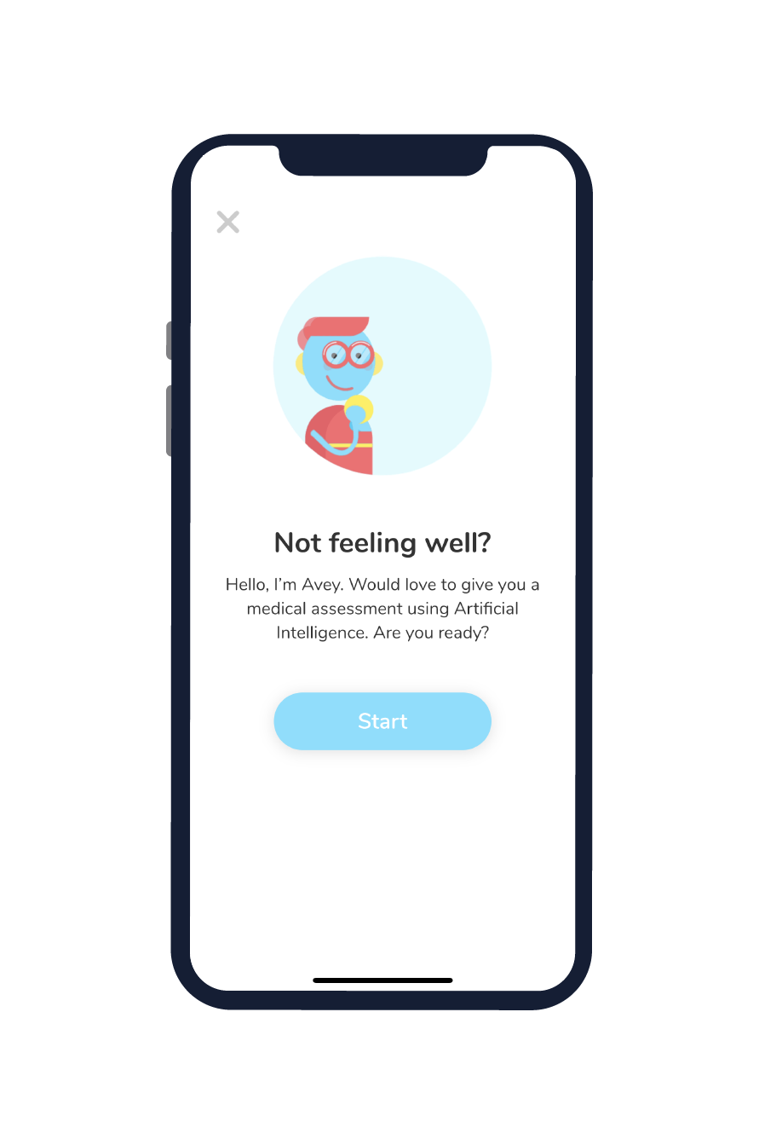
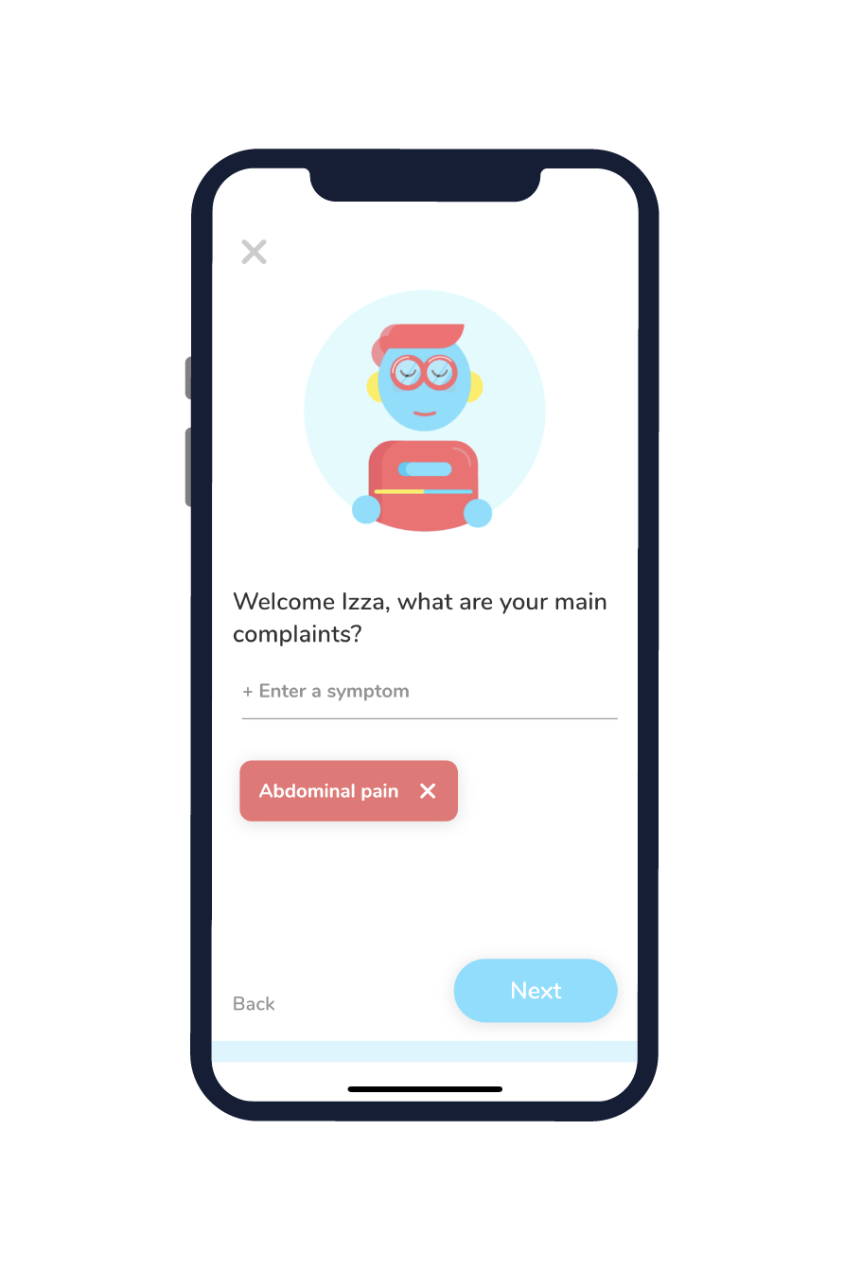
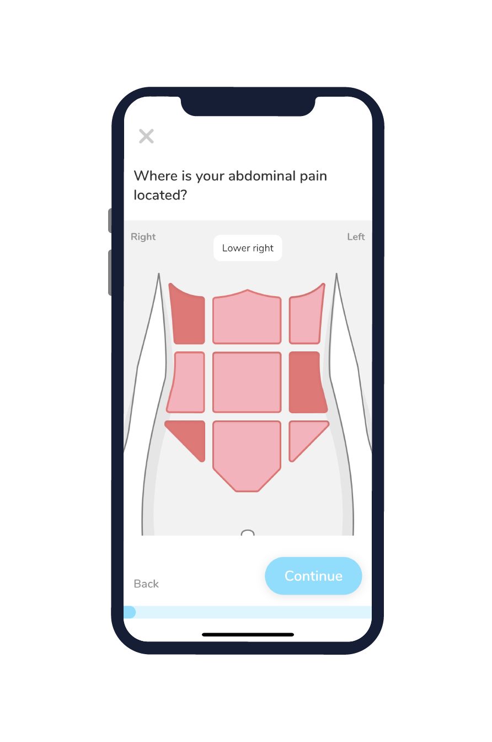
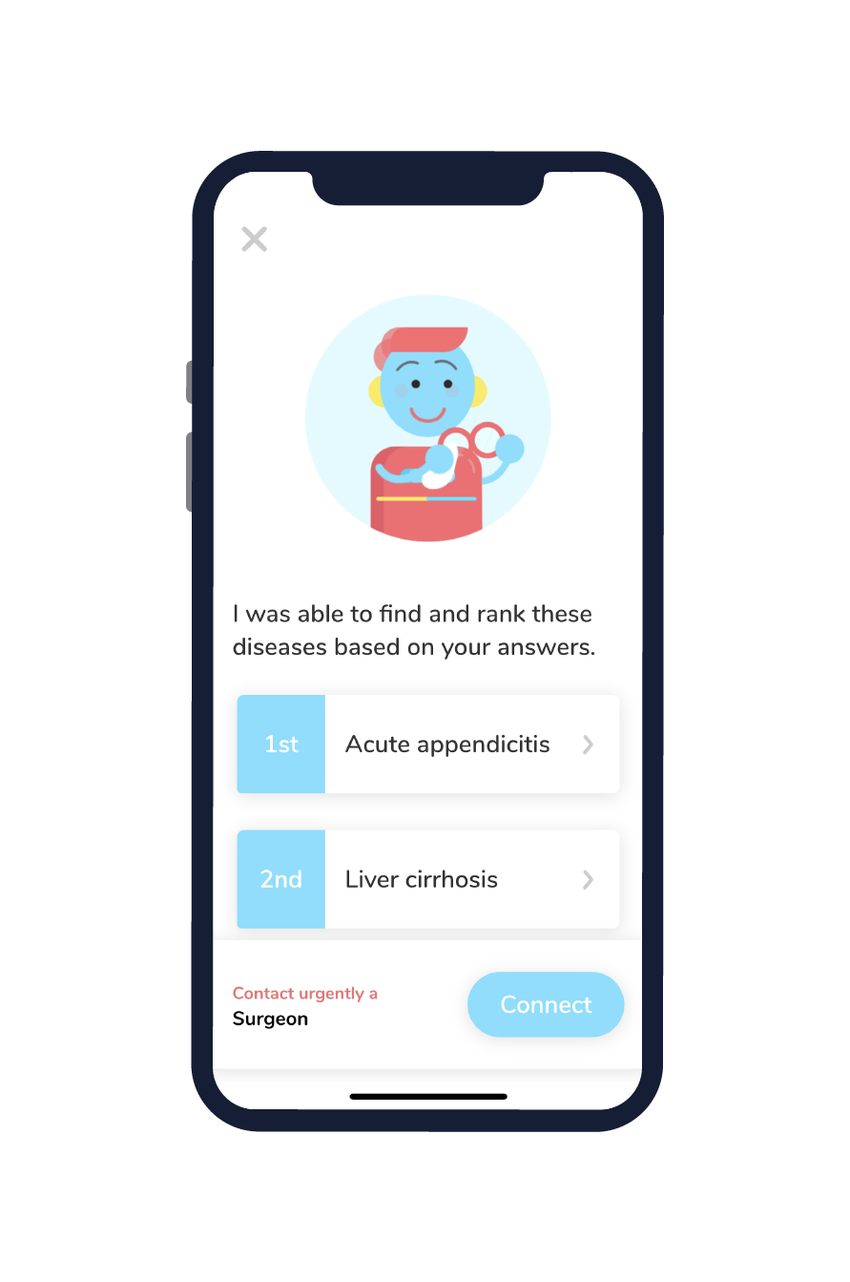
Avey: An AI-based Algorithm for Self-Diagnosis
Avey utilizes probabilistic graphical models in AI to provide patients with immediate and accurate self-diagnoses
. . .

Slide 9
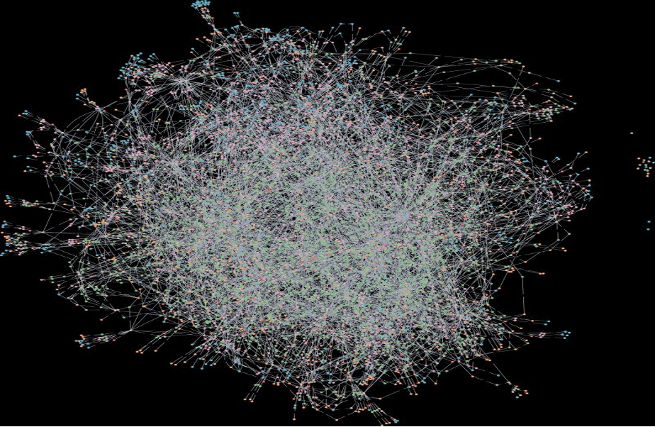
Avey’s Brain in Action
Avey: An AI-based Algorithm for Self-Diagnosis

Slide 10
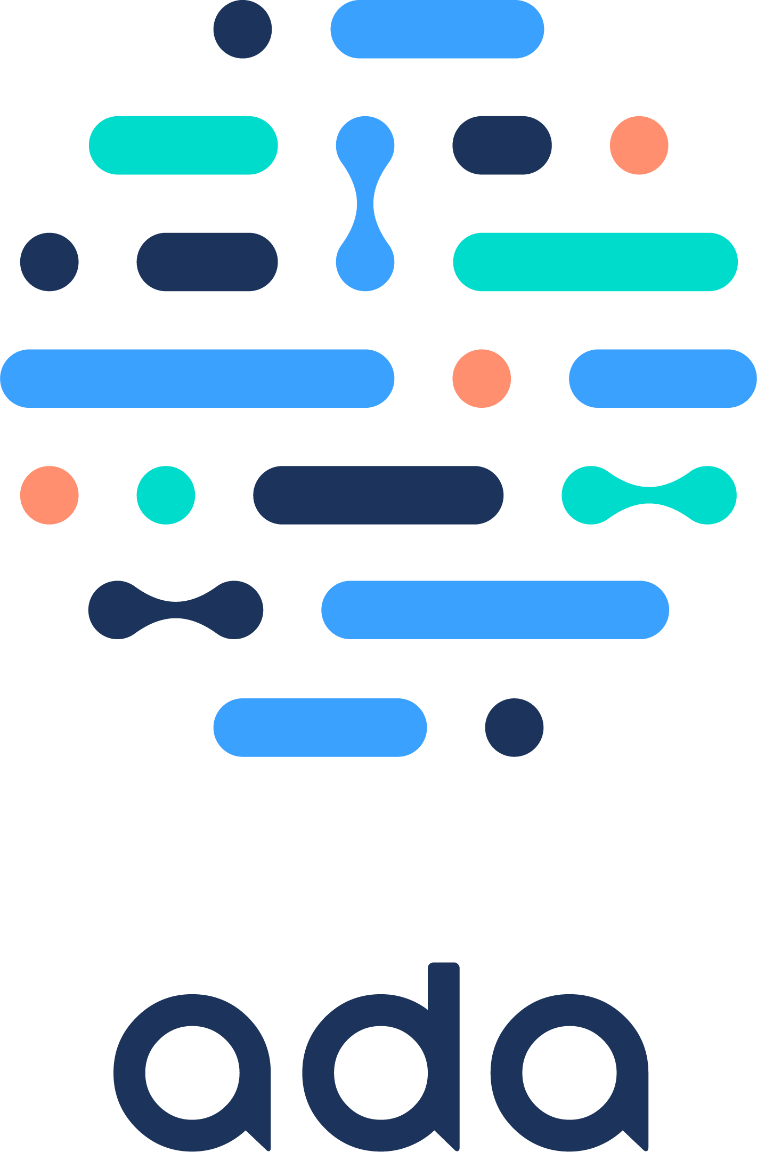
Avey: Experimentation Methodology
Stage 1: Vingette Creation
Stage 2: Vignette Standardization
Stage 3: Vignette Testing on Checkers
D₁
$$R_{v_{1}}$$
$$R_{v_{2}}$$
…….
$$R_{v_{n}}$$
$$R_{v_{1}}$$
$$R_{v_{2}}$$
…….
$$R_{v_{n}}$$
D₂
Test Vignettes on Checkers
$$R_{v_{1}}$$
$$R_{v_{2}}$$
…….
$$R_{v_{n}}$$
V₁
V₁
Counter = 3
$$R_{v_{1}}$$
$$R_{v_{2}}$$
…….
$$R_{v_{n}}$$
V₂
D₃
V₂
Counter = 5
$$R_{v_{1}}$$
$$R_{v_{2}}$$
…….
$$R_{v_{n}}$$
.
.
.
.
.
.
.
.
.
.
.
$$R_{v_{1}}$$
$$R_{v_{2}}$$
…….
$$R_{v_{n}}$$
Medical Sources
Compile Vignettes
D₄
Pool of Gold-Standard Vignettes
D₅
Stage 4: Vignette Testing on Doctors
D₆
$${MD}_{1}$$
$$R_{v_{1}}$$
$$R_{v_{2}}$$
…….
$$R_{v_{n}}$$
V_{n}
V_{n}
Test Vignettes on Doctors
Counter = 5
$${MD}_{2}$$
…….
$$R_{v_{1}}$$
$$R_{v_{2}}$$
$$R_{v_{n}}$$
D₇
$${MD}_{3}$$
…….
$$R_{v_{1}}$$
$$R_{v_{2}}$$
$$R_{v_{n}}$$

Slide 11
Avey versus Other Symptom Checkers

Slide 12
Avey versus Human Doctors

Slide 13
Some Applications of AI in Medicine
Diagnosing diabetic eye disease using deep learning [1]
Detecting anemia from retinal fundus images using deep learning [2]
Predicting cardiovascular risk factors from retinal fundus photographs using deep learning [3]
Extracting symptoms and their status from clinical conversations using recurrent neural networks [4]
Performing differential diagnosis using probabilistic graphical models [5]
Predicting osteoarthritis using machine learning [6]

Slide 14
And the Power of AI is Yet to Usher
The first medical image ever taken was in 1895 by Wilhelm Röntgen
This allowed looking inside a human body without slicing someone open!
Since then, medical imaging has represented the fastest growing source of medical data and literally changed the face of medicine
Imaging can sometimes reveal a disease before we feel it
For several diseases (e.g., cancer), the earlier we diagnose them the more likely the patients will survive, let alone reducing pain, suffering, cost, etc.

Slide 15
Discovery and Visualization of Structural Biomarkers from MRI using Machine Learning
That is why we screen people who exhibit no signs or symptoms yet
But, the earlier we capture images, the smaller & smaller the visible evidences of diseases become, until they vanish before our naked eyes
How early can we detect diseases?
There is a growing belief that there is an invisible side to imaging!
These are small changes (or hidden patterns) that are imperceptible to humans
Yet, they can be detected by AI!

Slide 16
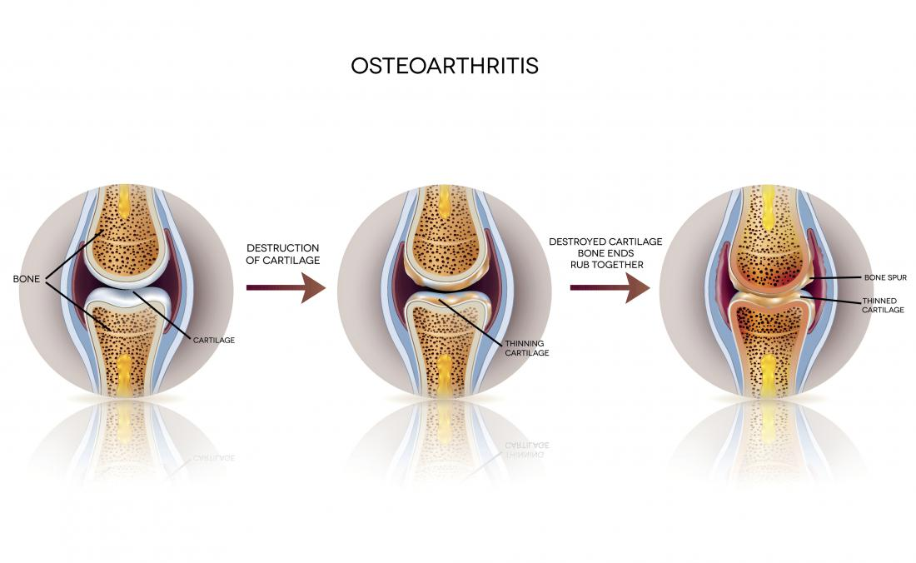
Discovery and Visualization of Structural Biomarkers from MRI using Machine Learning
One in 10 develop knee osteoarthritis, which cannot be detected until the damage has occurred
Notes:
Osteoarthritis is the most common form of arthritis, affecting millions of people worldwide. It occurs when the protective cartilage that cushions the ends of your bones wears down over time.
Although osteoarthritis can damage any joint, the disorder most commonly affects joints in your hands, knees, hips and spine.
There is an evidence that the disease begins long before inside the cartilage. So why not looking inside the cartilage to diagnose the disease?

Slide 17
Discovery and Visualization of Structural Biomarkers from MRI using Machine Learning
Here are scans that belong to different subjects, with different colors representing different ingredients that make up the cartilage
Group A
Group B
Which group has osteoartherits? Best experts cannot tell!

Slide 18
Discovery and Visualization of Structural Biomarkers from MRI using Machine Learning
Here are scans that belong to different subjects, with different colors representing different ingredients that make up the cartilage
Group A
Group B
NO osteoarthritis in 3 years
Osteoarthritis in 3 years

Slide 19
Discovery and Visualization of Structural Biomarkers from MRI using Machine Learning
This can be predicted using a machine learning algorithm that applies a technique known as “transport based morphometry”
The algorithm is able to predict whether a person will develop osteoarthritis 3 year down the line with an accuracy of 86.2%
The algorithm can learn more with experience, hence, it will only get better and better as we feed it with more scans

Slide 20
Discovery and Visualization of Structural Biomarkers from MRI using Machine Learning
But what does this algorithm see that doctors cannot?
The diffusion of water
The pooling of water at the center of the
cartilage suggests that there is a weakening
of cartilage at that location
Water is evenly distributed throughout the cartilage

Slide 21
Discovery and Visualization of Structural Biomarkers from MRI using Machine Learning
This can augment our capability and help us identify new targets for treatments
Can we apply this technique to other diseases (e.g., Alzheimer, autism, schizophrenia)?
If so, can we halt them before they even begin?
Just like in 1985 when the first image was taken, the face of medicine is about to change again
At that time we were able to see the visible
Now, we can see the invisible through AI!

Slide 22
Next Monday’s Lecture…
Machine Learning: Core Concept

Slide 23
References
Gulshan, Varun, et al. "Development and validation of a deep learning algorithm for detection of diabetic retinopathy in retinal fundus photographs." Jama 316.22 (2016): 2402-2410.
Mitani, Akinori, et al. "Detection of anaemia from retinal fundus images via deep learning." Nature Biomedical Engineering 4.1 (2020): 18-27.
Poplin, R., et al. "Predicting cardiovascular risk factors from retinal fundus photographs using deep learning. arXiv 2017." arXiv preprint arXiv:1708.09843.
Du, Nan, et al. "Extracting symptoms and their status from clinical conversations." arXiv preprint arXiv:1906.02239 (2019).
Hammoud, M., et al. “Avey: An Accurate AI Algorithm for Self-Diagnosis”.
Kundu, Shinjini, et al. "Discovery and visualization of structural biomarkers from MRI using transport-based morphometry." NeuroImage 167 (2018): 256-275.

